Slide 1
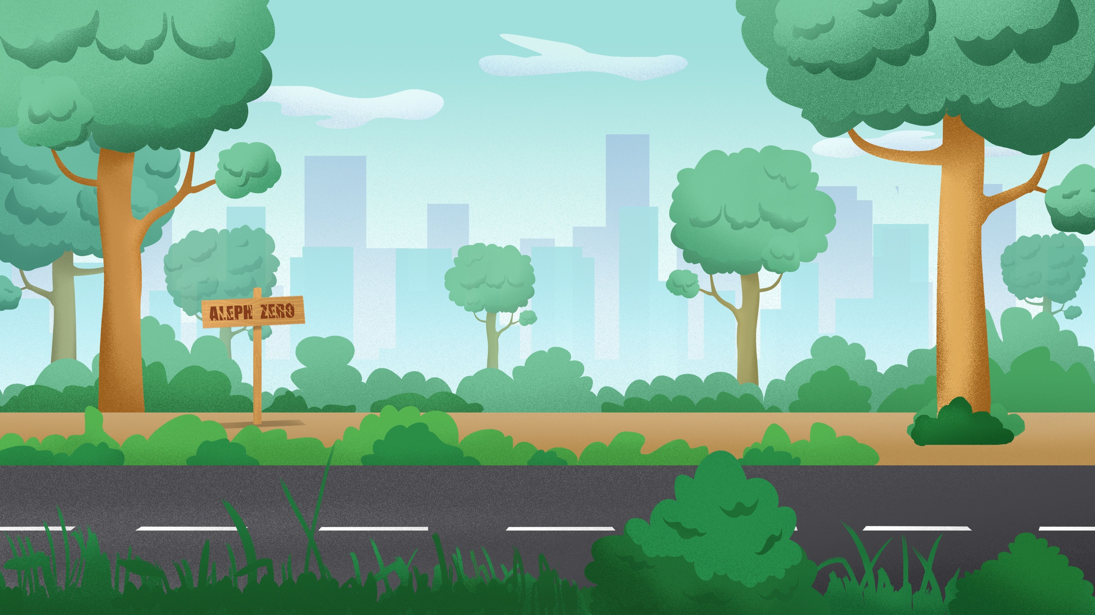
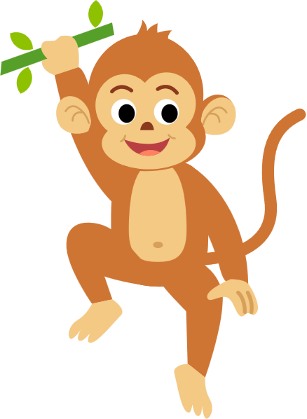

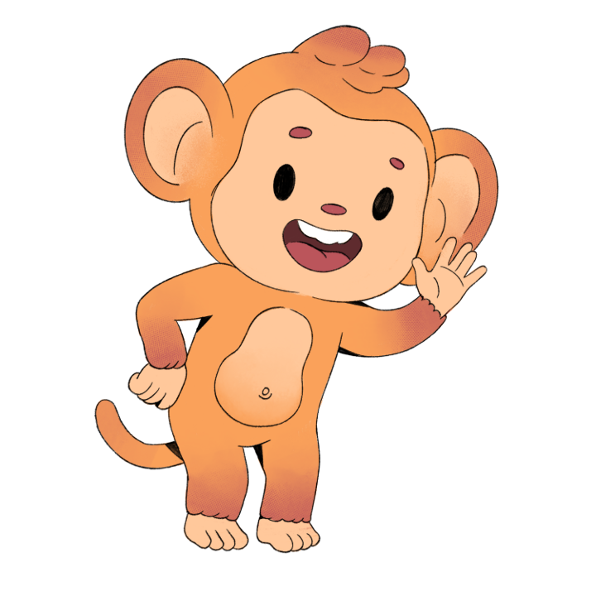
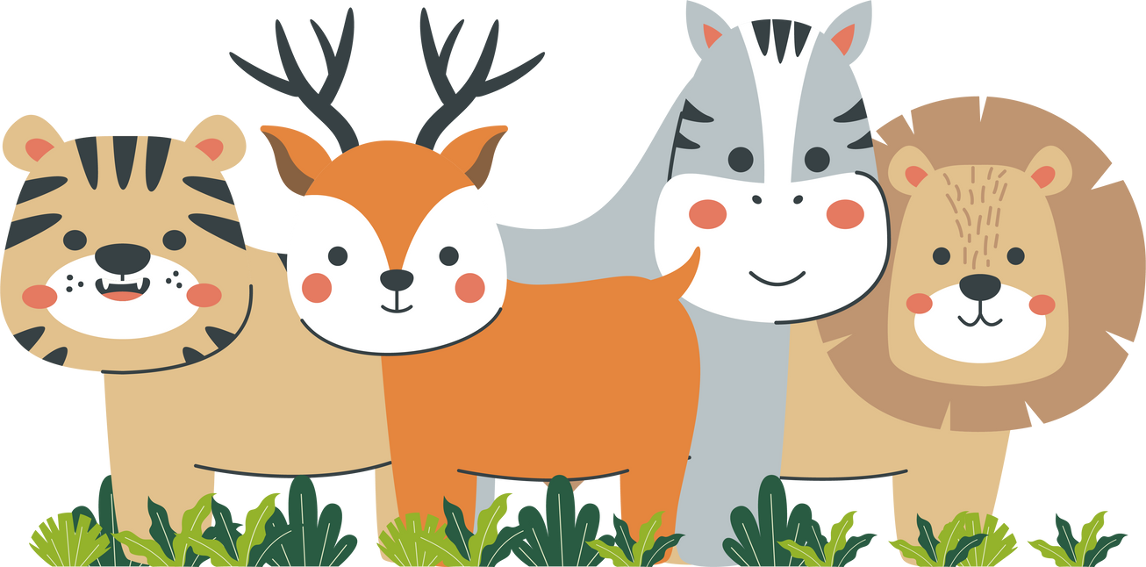
JUNGLE TUNE
PRESENTED BY
PRINCE
B.TECH(CS&AI)
12200813

Slide 2






•Certification:ISO 9001:2015
certified
•Specializations:
- Web Development
- Mobile Application Development
- Custom Software Development
- UI/UX Design
- Hosting Services
- Digital Marketing
•Services:
- Advanced IT solutions supporting the entire business
- Consulting to system
development
- Deployment
- Quality Assurance
- 24x7 Support
•Headquarters: Jalandhar
•Branch Office: Hoshiarpur

Slide 3
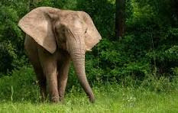



TABLE OF CONTENT
01
INTRODUCTION:WHY THIS? AND USES
02
06
STAGES OF ANALYSIS
KEY STEPS
03
07
DATA FLOW DIAGRAM
WORKFLOW
04
REQUIREMENTS
08
FUTURE SCOPE
05
09
CONCUSION
FRONTEND AND BACKEND

Slide 4
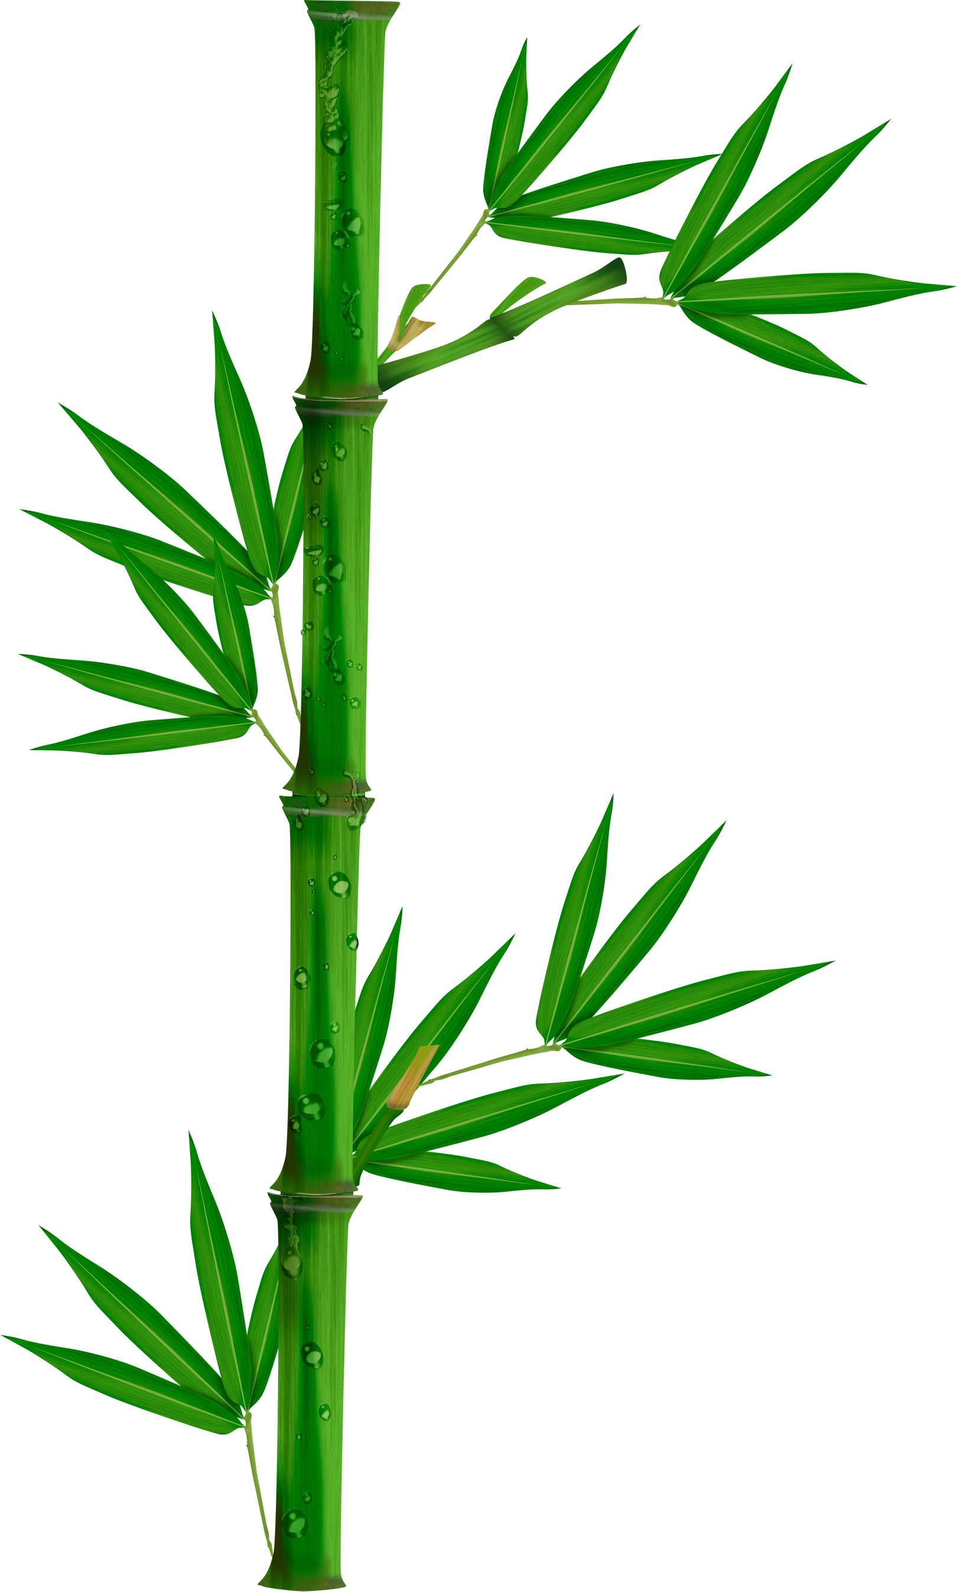





INTRODUCTION
Sound classification Project is a subset of audio signal processing and machine learning that focuses on identifying and categorizing sounds. When applied to animal voice classification, it aims to automatically detect and identify animal species based on their vocalizations (calls, chirps, roars, etc.).
It involves processing raw audio data and extracting meaningful features to train ML models

Slide 5

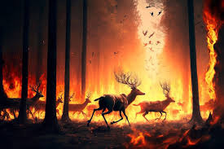
WHY ANIMAL SOUND CLASSIFICATION
(USES)
Automatic Identification
Handles Complex Sounds
Farm Animal Health Monitoring
Fast And Efficient
Disaster and Poaching Event Warning
Education and Interaction
User Friendly

Slide 6






KEY STEPS IN ML PIPELINE
Audio Input
Recordings of animal sounds from various sources
Feature Extraction
Transform soundwaves into numerical features using techniques like MFCCs.
Model Training
Train machine learning models to identify patterns classify sounds.
Classification
Predict the animal species based on the input audio.

Slide 7


WORKFLOW
Data Collection
Preprocessing
Feature Extraction Common features
Model Training Common ML/DL models used
Model Evaluation
Deployment

Slide 8
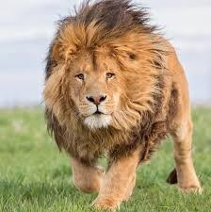
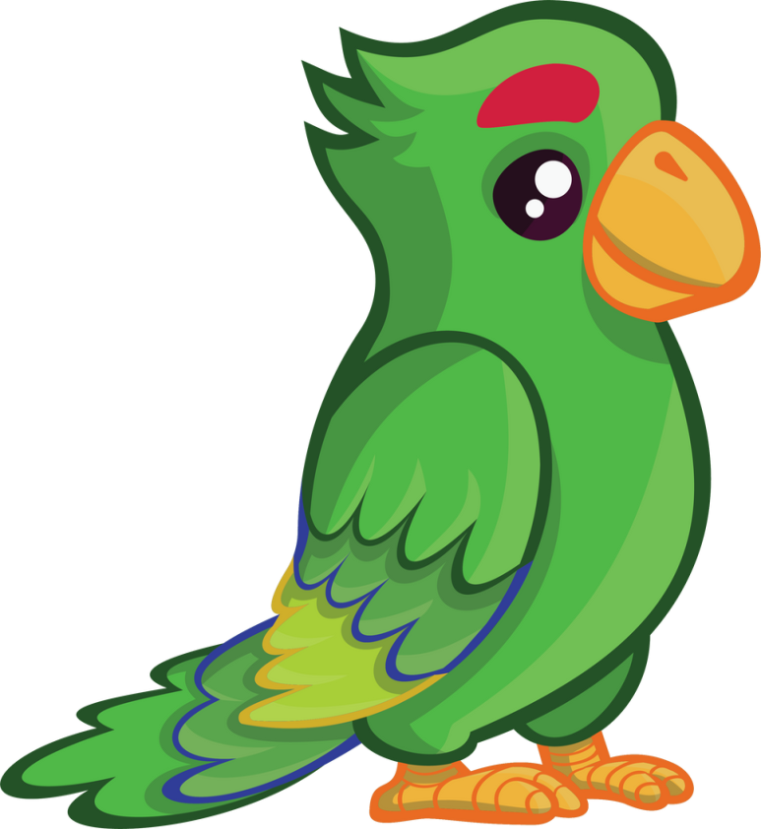

REQUIREMENT’S FOR PROJECT
RESOURCE
Kaggle
VS code
Google colab
Jupyter
DATASET
https://www.kaggle.com/datasets/rushibalajiputthewad/sound-classification-of-animal-voice

Slide 9
TOOLS AND LIBRARIES
Librosa
Pydub
Tensorflow/keras,PyTorch
Soundfile/Wave
Matplotlib/Seaborn
Pandas
Streamlit

Slide 10




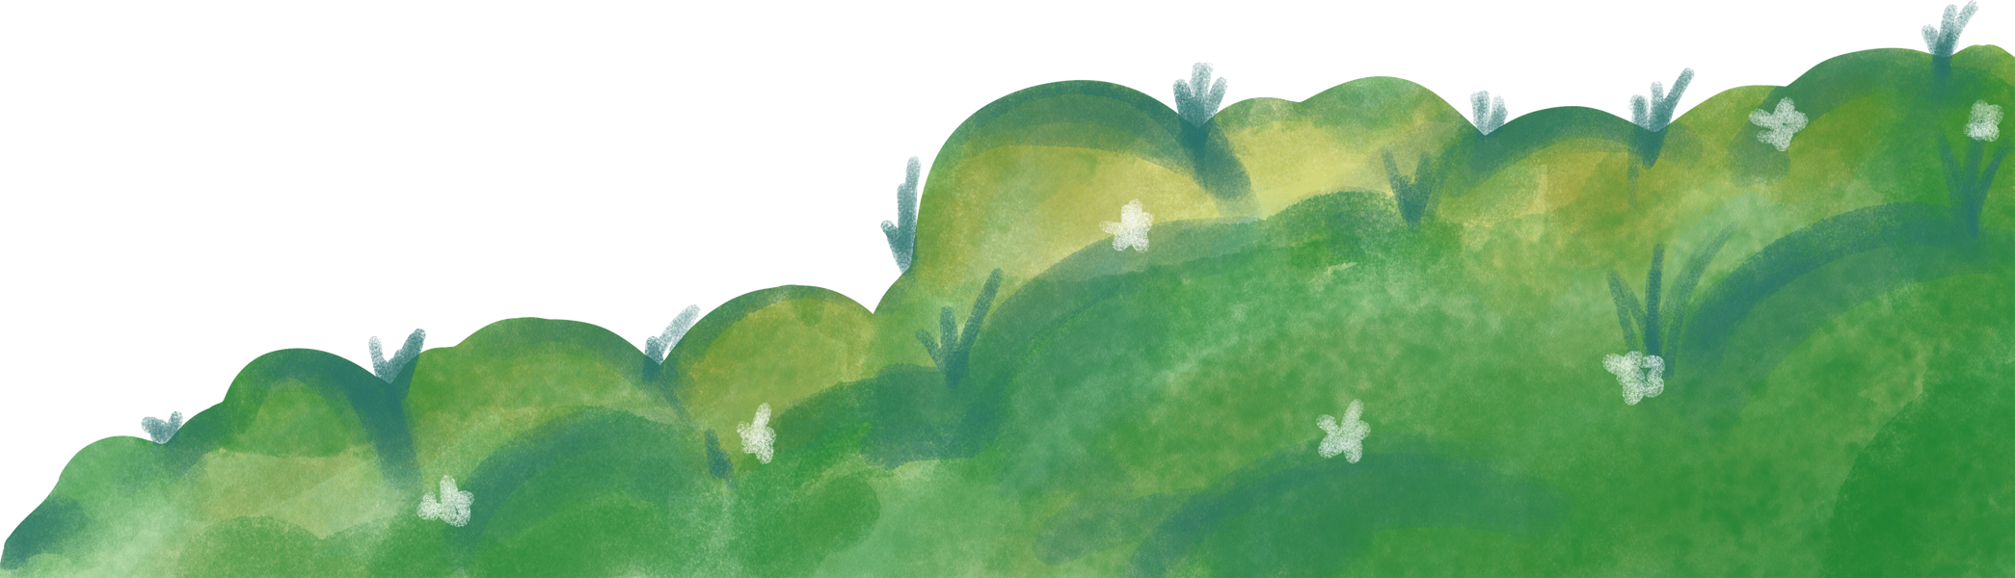


SOFTWARE REQUIREMENTS
PYTHON
CODE EDITOR

Slide 11

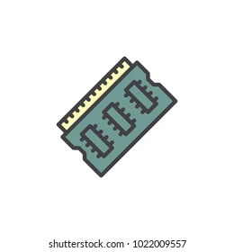

HARDWARE REQUIREMENTS
INTEL i5 Core,
RYZEN 5
RAM(8/16 gb)
GEFORCE GTX

Slide 12

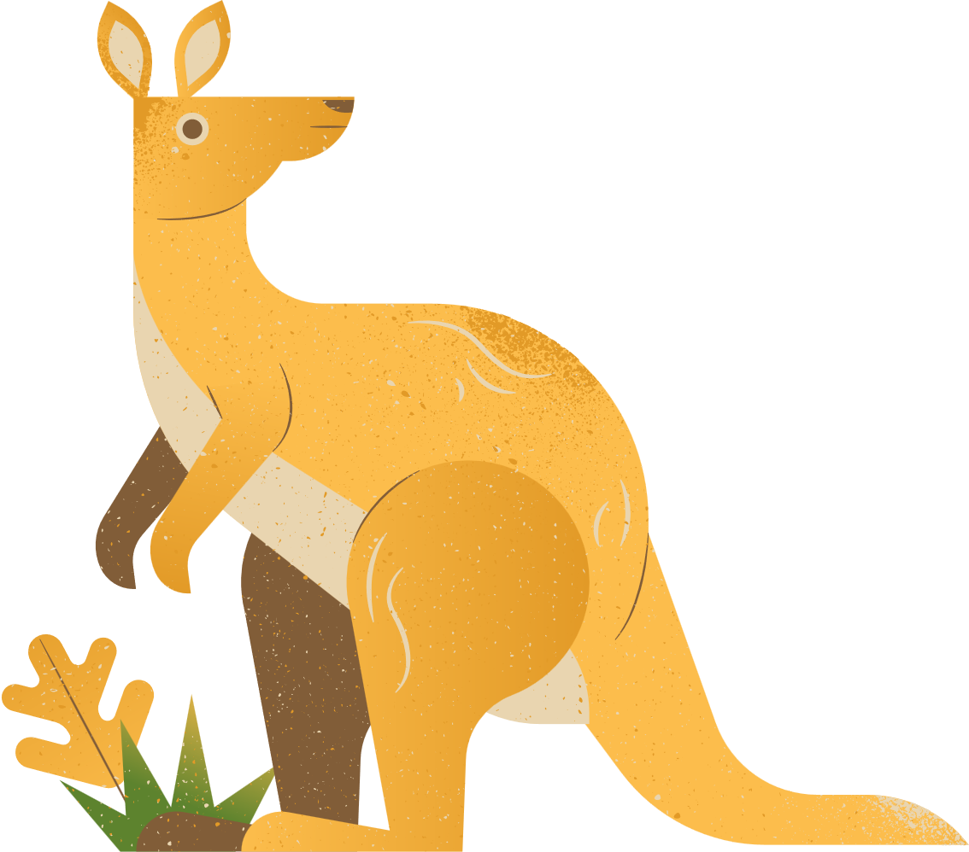


FRONT END
BACKEND
STREAMLIT
CSS
PYTHON

Slide 13

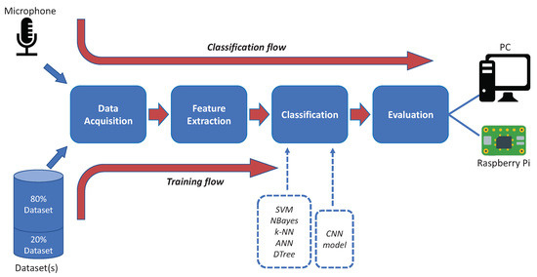

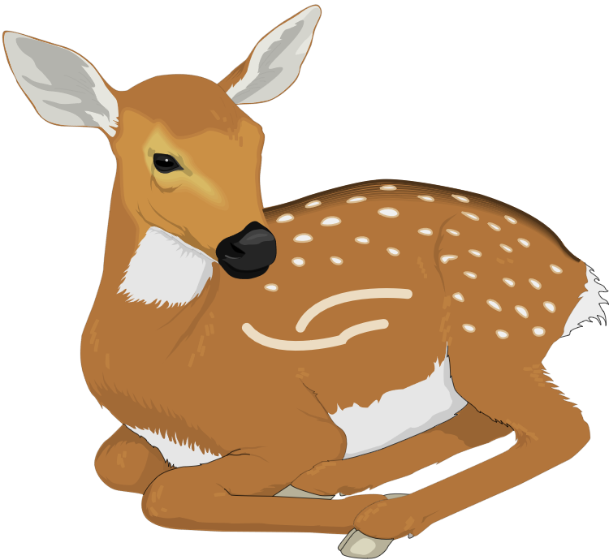
STAGES OF ANALYSIS

Slide 14
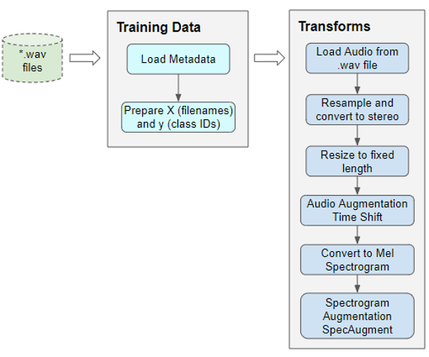


Slide 15
LEVEL-0 DFD
SOUND CLASSIFICATION ML SYSTEM
AUDIO FILES
DATA FLOW
DIAGRAM
CLASSIFIED ANIMAL SOUND(OUTPUT)

Slide 16
LEVEL-1 DFD
1. Collect Audio Input
2. Pre-process Audio
ANIMAL SOUND SOURCE
RAW AUDIO
CLEANED
AUDIO
5. Output Classification
(e.g., Dog, Cat, Lion)
4. Classification ML Model (e.g., CNN,SVM, etc.)
3. Feature Extraction
(MFCC, Chroma, etc.)
ANIMAL TYPE
FEATURES

Slide 17
DFD – DEPLOYMENT OF AUDIO CLASSIFICATION ON
STREAMLIT
STREAMLIT WEB INTERFACE(AUDIO CLASSIFIER)
USER
UPLOAD AUDIO
CLASSIFICATION
DISPLAY RESULT

Slide 18



FUTURE SCOPE
Animal Emotion Recognition
Image Recognition
AI-Powered Animal Translator Apps
Self-Learning Systems

Slide 19

CONCLUSION
Sound classification of animal voice using machine learning is a powerful and efficient approach to identifying and analyzing animal sounds. It enables automatic recognition of animal species based on their vocal patterns, which is useful in wildlife monitoring, protect from predators , detect distress level etc.
As ML technology advances, the scope of animal sound classification
will continue to grow—making it smarter, faster, and more accessible
for real-world ecological and agricultural solutions

Slide 20
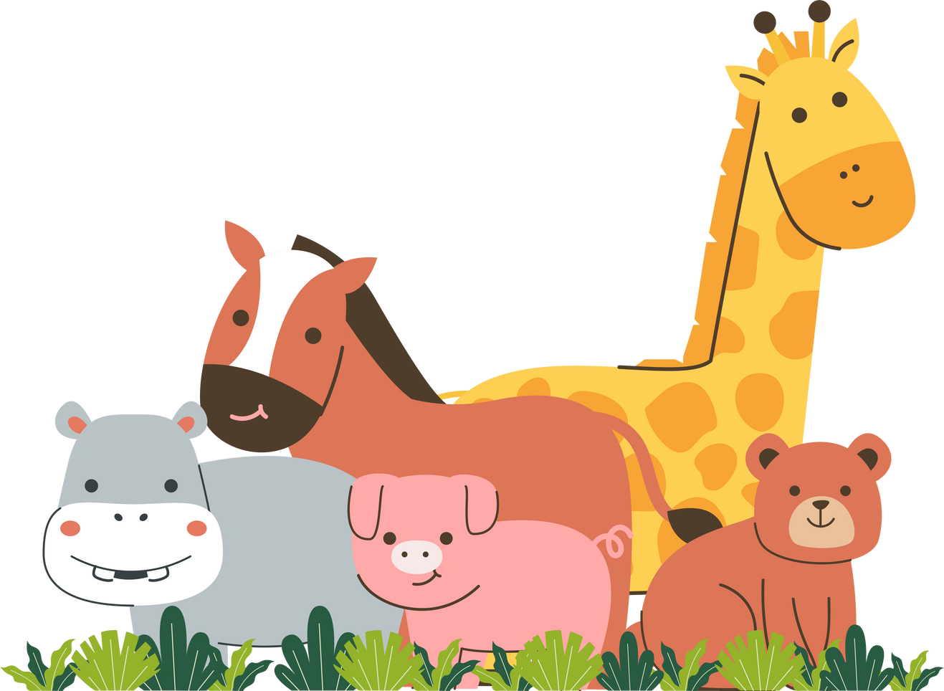
THANK YOU

